Slide 1
Loader Design Options
Linkage Editors
Dynamic Linking
Bootstrap Loaders

Slide 2
Linkage Editors
Difference between a linkage editor and a linking loader:
  Linking loader
    performs all linking and relocation operations, including automatic library search, and loads the linked program into memory for execution.
  Linkage editor
    produces a linked version of the program, which is normally written to a file or library for later execution.
      A simple relocating loader (one pass) can be used to load the program into memory for execution.
      The linkage editor performs relocation of all control sections relative to the start of the linked program.
      The only object code modification necessary is the addition of an actual load address to relative values within the program.

Slide 3
Linkage Editors
Difference between a linkage editor and a linking loader:
  Linking loader
    Suitable when a program is reassembled for nearly every execution
      In a program development and testing environment
      When a program is used so infrequently that it is not worthwhile to store the assembled and linked version.
  Linkage editor
    Suitable when a program is to be executed many times without being reassembled because resolution of external references and library searching are only performed once.

Slide 4
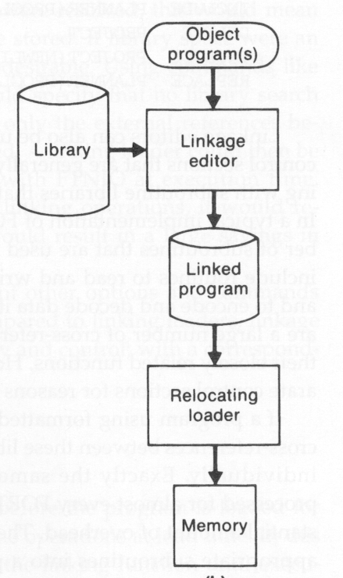
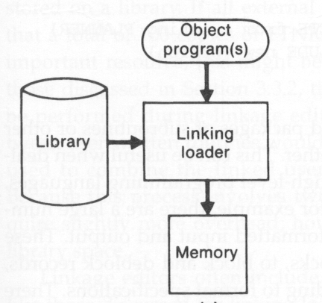
Linking Loader vs. Linkage Editor

Slide 5
Additional Functions of Linkage Editors
Replacement of subroutines in the linked program
  For example:
    INCLUDE PLANNER(PROGLIB)
    DELETE PROJECT
    INCLUDE PROJECT(NEWLIB)
    REPLACE PLANNER(PROGLIB)
Construction of a package for subroutines generally used together
  There are a large number of cross-references between these subroutines due to their closely related functions.
  For example:
    INCLUDE READR(FTNLIB)
    INCLUDE WRITER(FTNLIB)
    :
    SAVE FTNIO(SUBLIB)
Specification of external references not to be resolved by automatic library search
  Can avoid multiple storage of common libraries in programs.
  Need a linking loader to combine the common libraries at execution time.

Slide 6
Address Binding
Address Binding:
  Symbolic Address (label) ➔ Machine Address
Address Binding:
  Assembling Time: 8051
  Load Time: 8086
  Run Time: Dynamic Linking Library
Address Binding
  Complexity, Flexibility

Slide 7
Linking Time
Linkage editors: before load time
Linking loaders: at load time
Dynamic linking: after load time
  A scheme that postpones the linking function until execution time.
  A subroutine is loaded and linked to the test of the program when it is first called.
  Other names: dynamic loading, load on call

Slide 8
Dynamic Linking Application
Allows several executing programs to share one copy of a subroutine or library.
Allows the implementation of the shared object and its methods to be determined at execution time in an object-oriented system
Provides the ability to load the routines only when (and if) they are needed.
  This can result in substantial savings of load time and memory space.
  For example, error handling routines.

Slide 9
Implementation of Dynamic Linking
Subroutines to be dynamically loaded must be called via an operating system service request, e.g., load-and-call, instead of executing a JSUB instruction.
The service request will be handled by a part of the OS, called the dynamic loader, which is kept in memory during execution of the program.
The parameter of this request is the symbolic name of the routine to be called..

Slide 10
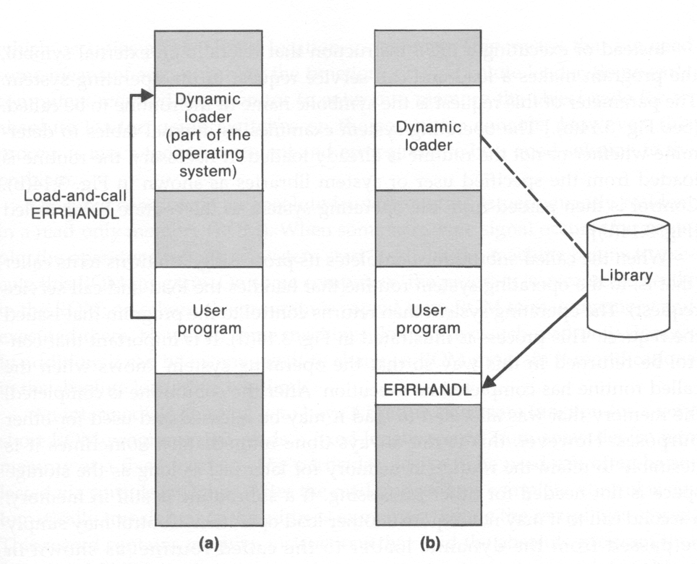
Example of Dynamic Linking
Issue a load-and-call request
Load the routine from the specified library

Slide 11
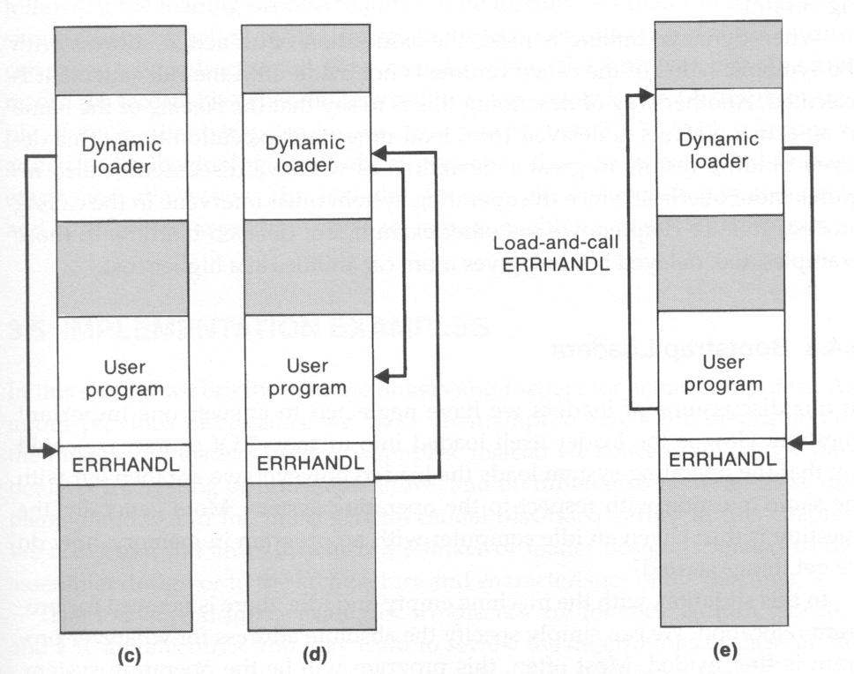
Jump back to the dynamic loader
Jump to the
loaded routine
Jump back to the user program
Second call to this subroutine
may not require load operation.

